Slide 1
L.O: To calculate the mode and median
Today we will be learning how to calculate the mode and median from a set of data. However, as always, we will start with a range of warm ups.

Slide 2
Let’s recap
27m
14m
Calculate the perimeter and area.

Slide 3
Let’s recap
Complete these chains:
0.4 4 40%
10
Complete these chains:
0.8 %
10
Complete these chains:
0.36 %
100

Slide 4
This week, we will be learning how to calculate the mode, median, mean and range from a set of numbers.
First of all, let’s look at how we
find the mode and median.

Slide 5
What is the mode?
The mode is the most common number.
What about the median?
The median is the middle number.

Slide 6
What is the mode?
Example:
7, 2, 9, 2, 5
2, 2, 5, 7, 9
What about the median?

Slide 7
What is the mode?
14, 8, 17, 17, 13
8, 13, 14, 17, 17
What about the median?

Slide 8
What is the mode?
14, 8, 17, 17, 13
8, 13, 14, 17, 17
What about the median?

Slide 9
What is the mode?
15, 12, 7, 11, 11
8, 13, 14, 17, 17
What about the median?

Slide 10
L.O: To calculate the mode and median
Must
3, 1, 5, 5, 2 2) 4, 1, 3, 9, 4 3) 8, 1, 1, 1, 5 4) 9, 2, 5, 2, 7
5) 12, 5, 7, 5, 13 6) 10, 8, 8, 13, 17 7) 12, 2, 12, 5, 9 8) 13, 1, 8, 1, 15
Should
1) 13, 11, 5, 13, 2 2) 14, 1, 13, 13, 8 3) 18, 1, 12, 12, 27 4) 13, 22, 25, 22, 37
8, 15, 15, 24, 13 6) 13, 8, 24, 13, 17 7) 22, 33, 22, 5, 49 8) 21, 15, 8, 33, 15
9) 24, 34, 44, 34, 99 10) 47, 38, 19, 55, 47 11) 36, 48, 99, 55, 21, 71, 48
Could
12, 8, 33, 59, 44, 9, 33 2) 32, 25, 32, 21, 21, 32, 87
44, 39, 58, 107, 59, 44, 101 4) 39, 58, 45, 85, 94, 94, 36
5) 108, 95, 36, 84, 55, 109, 95 6) 47, 81, 19, 65, 204, 134, 204
Bonus: 47, 85, 99, 51, 94, 103, 27, 93, 51

Slide 11
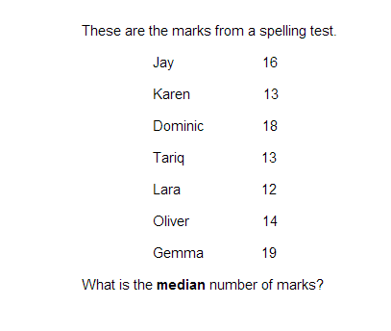
SAT challenge.

Slide 12
L.O: To calculate the median from an even set of numbers
Following on from yesterday, we will be furthering our understanding of averages. However, this time we will calculating the median from an even set of numbers.
But first, time for our daily warm up…

Slide 13
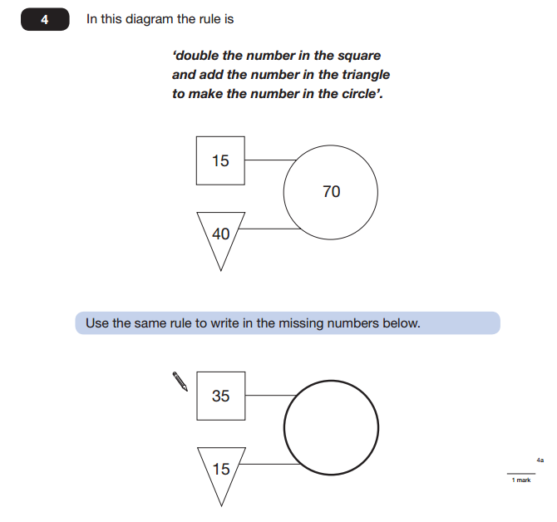

Slide 14
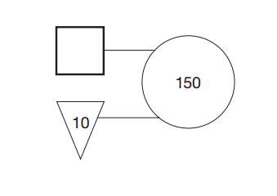
What do you need to do now?

Slide 15
= 16.8
+
+
= 22.2
+
+

Slide 16
What is the mode?
The mode is the most common number.
What about the median?
The median is the middle number.

Slide 17
What is the mode?
Example:
7, 2, 9, 2, 5
2, 2, 5, 7, 9
What about the median?

Slide 18
What is the mode?
1.3, 1.5, 1.37, 1.70, 1.30
1.30, 1.30, 1.37, 1.50, 1.70
What about the median?

Slide 19
What is the mode?
3.6, 3.64, 3.7, 3.60, 3.09
3.09, 3.60, 3.60, 3.64, 3.70
What about the median?

Slide 20
Today, we will be looking at how to find the median when there is an even set of numbers.
35, 14, 18, 15, 64, 25
14, 15, 18, 25, 35, 64
As there are two middle numbers you must:
add the numbers together, then divide by two.

Slide 21
38, 59, 24, 7, 38, 21
7, 21, 24, 38, 38, 59
Add the numbers together, then divide by two.
3 1
24 + 38 = 62
2
6 2

Slide 22
45, 42, 38, 19, 55, 68
19, 38, 42, 45, 55, 68
Add the numbers together, then divide by two.
4 3 . 5
42 + 45 = 87
2
8 7 . 0
1

Slide 23
L.O: To calculate the median from an even set of numbers
Must
4, 1, 5, 8, 2) 4, 1, 3, 12 3) 8, 13, 6, 5 4) 9, 3, 5, 2,
12, 5, 7, 2 6) 10, 8, 7, 13 7) 12, 14, 12, 9 8) 13, 17, 8, 12
9) 24, 38, 21, 37 10) 27, 33, 51, 48 11) 37, 52, 49, 67 12) 24, 38, 9, 36
Should
1) 34, 56, 31, 34 2) 37, 29, 84, 63 3) 84, 79, 58, 91 4) 64, 55, 77, 81
5) 57, 81, 69, 74 6) 84, 79, 93, 97 7) 64, 78, 54, 93 8) 91, 30, 44, 86
Could
34, 56, 31, 34, 42, 53 2) 37, 29, 84, 63, 74, 54
3) 48, 95, 32, 77, 52, 30 4) 47, 36, 24, 88, 63, 73
Bonus: 47, 85, 99, 51, 94, 103, 27, 93,

Slide 24
L.O: To calculate the mean from a set of data
In todays lesson we will adding to our knowledge of averages as we will be looking at how to calculate the mean from a set of data.
First of all, let’s warm up with some challenging recaps.

Slide 25
Let’s recap
Round these to the nearest tenth (1dp).
3.74
9.681
13.946
25.3874

Slide 26
Let’s recap
Round these to the nearest hundredth (2dp).
3.742
8.485
18.274
35.748

Slide 27
Let’s recap
Calculate the median.
62, 45, 57, 68, 94, 94
45, 57, 62, 68, 94, 94
62 + 68 = 130
2
1 3 0

Slide 28
Let’s recap
Calculate the median.
22, 85, 21, 67, 84, 22
21, 22, 22, 67, 84, 85
22 + 67 = 89
2
8 9 . 0

Slide 29
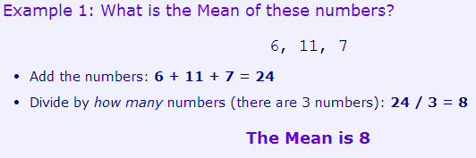
What is the mean?
The mean is the average of a set of numbers.
It’s easy to calculate: add up all the numbers, then divide by how many numbers they are.

Slide 30
Let’s look at another example together.
Firstly, I need three volunteers.
What data could we collect
from our volunteers?

Slide 31
L.O: To calculate the mean from a set of data
Must
5, 1, 5, 2) 8, 1, 4, 12 3) 8, 11, 6, 4) 11, 3, 6, 2, 2
9, 8, 7, 2 6) 10, 7, 7 7) 12, 13, 12, 8 8) 13, 17, 4, 12
9) 38, 21, 37 10) 27, 33, 21 11) 37, 22, 19 12) 24, 28, 19, 36
Should
1) 24, 36, 31, 34 2) 37, 29, 34, 33 3) 44, 59, 38, 41 4) 24, 35, 47, 51
5) 37, 51, 49, 54 6) 24, 59, 33, 27 7) 34, 48, 54, 63 8) 31, 30, 64, 76
Could
34, 56, 31, 34, 42, 2) 37, 29, 84, 63, 74
3) 48, 95, 32, 77, 30 4) 47, 36, 24, 88, 63
Bonus: 47, 85, 99, 51, 94, 103, 27, 93,

Slide 32
23m
16m
Using the diagram above, calculate the
area of the shape below.

Slide 33
What is the range?
Example:
13, 2, 8, 7, 5
2, 5, 7, 8, 13
What is the median?
What is the mean?

Slide 34
What is the range?
Example:
2, 7, 2, 5
2, 2, 5, 7
What is the median?
What is the mean?

Slide 35
What is the range?
Example:
12, 7, 8, 4, 4, 1
1, 4, 4, 7, 8, 12
What is the median?
What is the mean?

Slide 36
L.O: Calculate the median, mean and range from data I collected.
Today, working in groups, you will be collecting data and then calculating the median, mean and range from the results.
To begin with, let’s take a look at the worksheet you will be completing.

Slide 37
L.O: Calculate the median, mean and range from data I collected.
Name | Time

